Slide 1
Audio Demos for the Paper Speech Enhancement by LSTM-Based Noise Suppression Followed by CNN-Based Speech Restoration
Maximilian Strake, Bruno Defraene, Kristoff Fluyt, Wouter Tirry, Tim Fingscheidt

Slide 2
1 Introduction
We offer the following audio demos for the paper “Speech Enhancement by LSTM-Based Noise Suppression Followed by CNN-Based Speech Restoration”.
All the audio demos use files from the test dataset in the presence of unseen noise conditions at a signal-to-noise ratio (SNR) of 5 dB. The audios include speech from both female and male test speakers.
The unseen noise files are taken from the ETSI background noise database¹, which is a completely unseen database for our system (no noises from the ETSI database have been seen in training).
Audio examples are provided using “Pub Noise”, “Office Noise”, and “Traffic Noise”. Please note that the training of our model focuses on non-stationary noise types including interfering speech and the “Traffic Noise” example shows the generalization performance on a noise type not including interfering speech.
The identifiers for the different references and our proposed systems are exactly the ones used in the paper. The model LSTM-cMSA+CLED-cSA-du was pre-published in a conference paper [39], where we use the same reference identifier as in the article.
The modifications to the two-stage systems proposed in the article also concern the complexity of the second-stage network. To enable an easy comparison of the model complexity, we provide the real-time factor (ratio of average frame processing time and employed frame shift) measured for the respective two-stage systems.
39. [Strake, M., Defraene, B., Fluyt, K., Tirry, W., Fingscheidt, T.: Separated Noise Suppression and Speech Restoration: LSTM-Based
Speech Enhancement in Two Stages. In: Proc. of WASPAA, New Paltz, NY, USA, pp. 234–238 (2019)]
52. [ETSI EG 202 396-1: Speech Processing, Transmission and Quality Aspects (STQ); Speech Quality Performance in the Presence of
Background Noise; Part 1: Background Noise Simulation Technique and Background Noise Database. (2008)]
Notes:
During a communication, speech naturally come for us to pick up emotion content, since speech contains both emotion-related linguistic content, but also acoustic information.
2, SER can offer more intuitive human-to-machine interactions by allowing the machine to understand human emotions.
4, simulating or acting the emotions in a clear and natural way or getting unambiguous classes are a big challenge

Slide 3
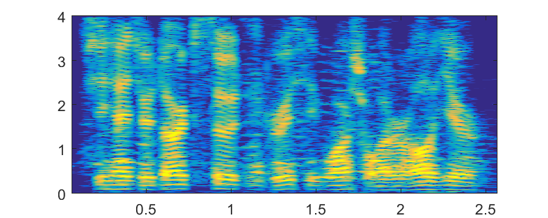
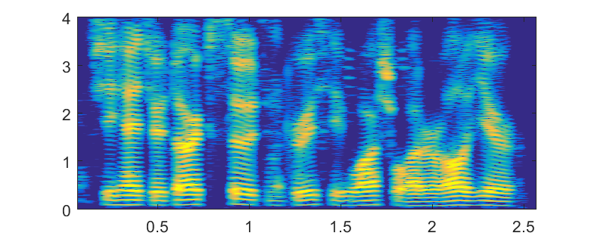

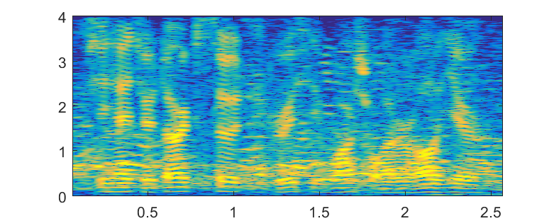
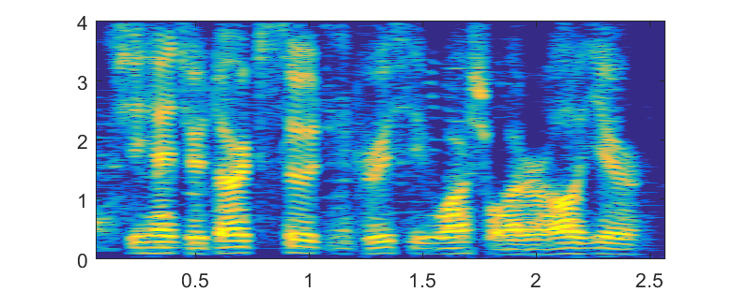

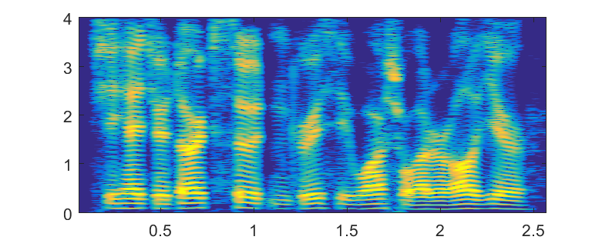
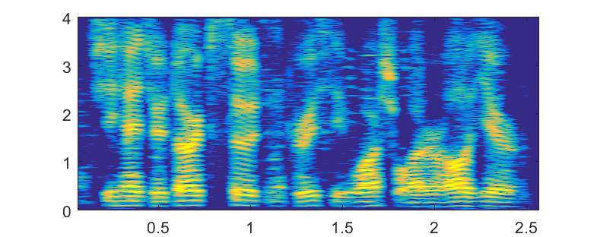

Audio Demos at SNR=5dB
Male Test Set Speaker in Unseen Pub Noise*
Single Stage Baselines
Two-Stage Systems
LSTM-IRM
LSTM-cMSA+CED-cSA-du
(new)
Noisy Speech
Frequency
Frequency
Real-time factor: 1.14
LSTM-MSA
LSTM-cMSA+CED-cSA-tr
(new)
Frequency
Clean Speech
Real-time factor: 0.68
Frequency
LSTM-cMSA
LSTM-cMSA+CLED-cSA-du
[39]
Frequency
Time
Time
Time
Real-time
factor: 1.85
*Please note that this example audio file is the same one as used for illustrating the analysis of our
proposed two-stage approach (c.f. section 5.4 and Figure 6 in the paper) and can be used as
accompanying material when reading this section of the paper.

Slide 4
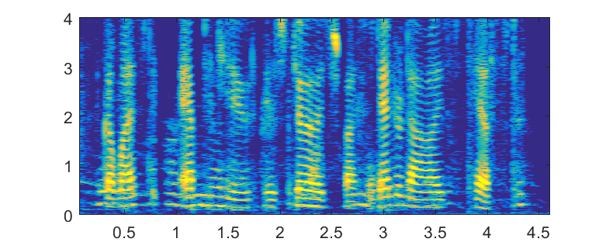
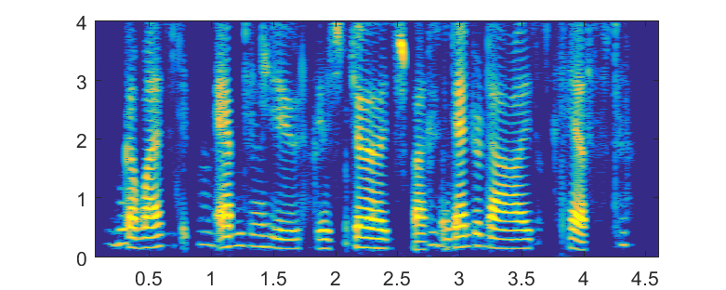
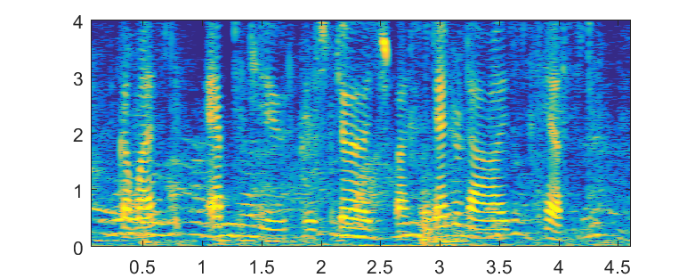
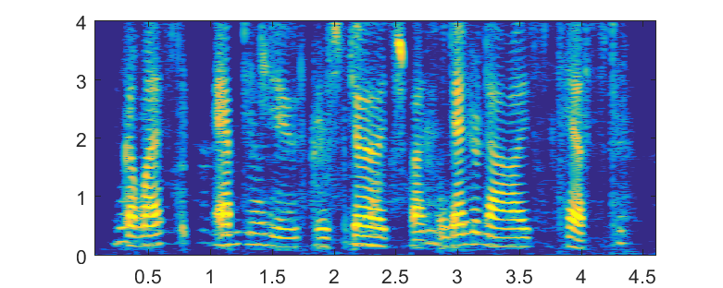
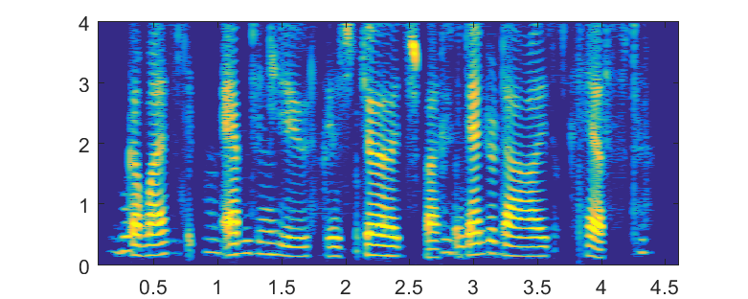
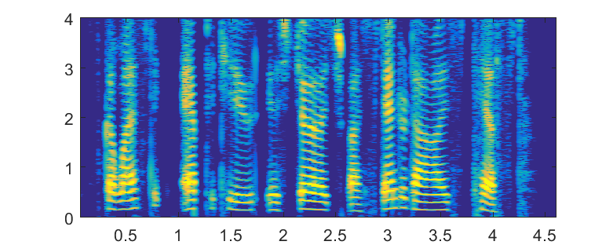


Audio Demos at SNR=5dB
Female Test Set Speaker in Unseen Office Noise
Single Stage Baselines
Two-Stage Systems
LSTM-IRM
LSTM-cMSA+CED-cSA-du
(new)
Frequency
Noisy Speech
Real-time factor: 1.14
Frequency
LSTM-MSA
LSTM-cMSA+CED-cSA-tr
(new)
Frequency
Clean Speech
Real-time factor: 0.68
Frequency
LSTM-cMSA
LSTM-cMSA+CLED-cSA-du
[39]
Frequency
Time
Time
Real-time
factor: 1.85

Slide 5
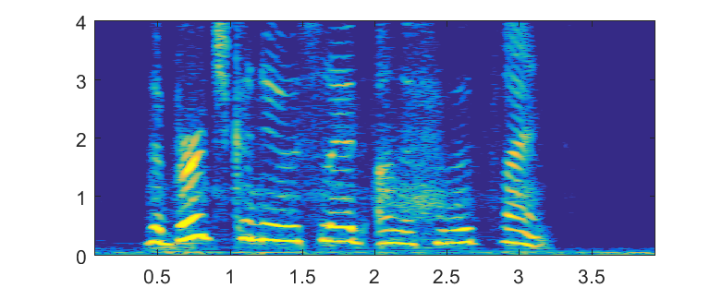
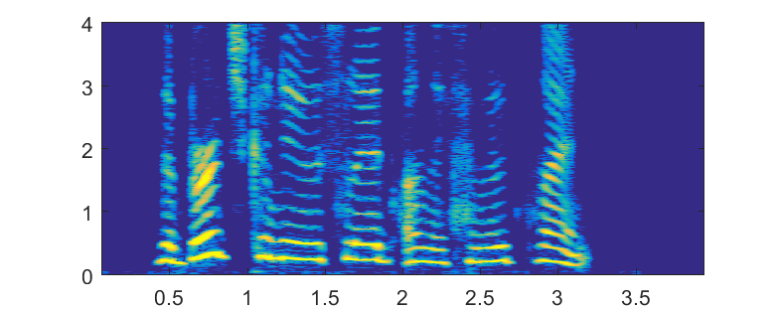
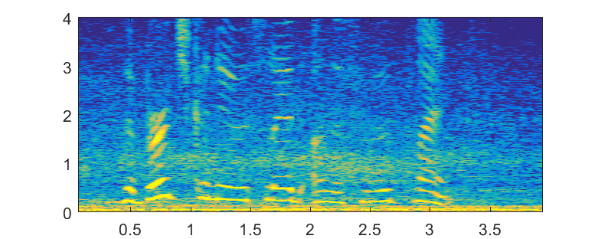
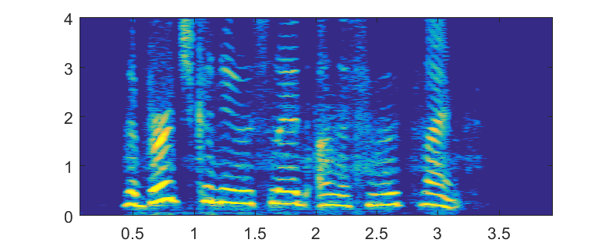
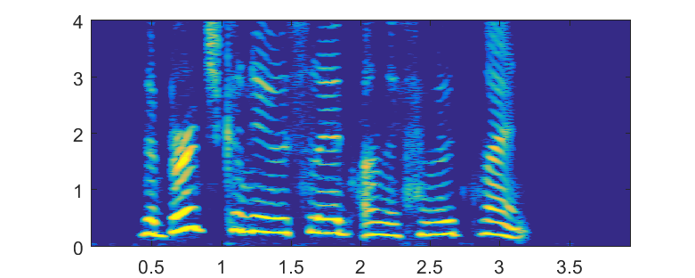
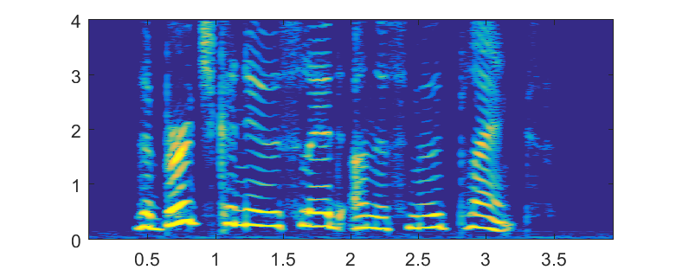
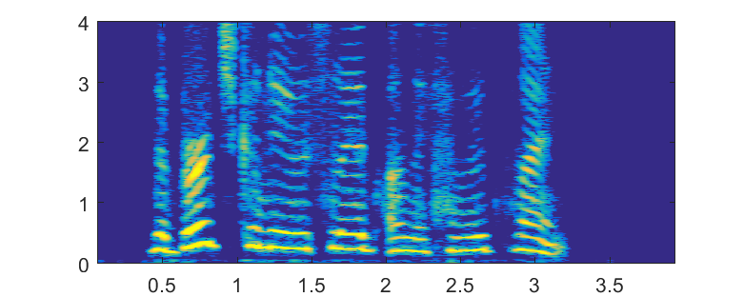
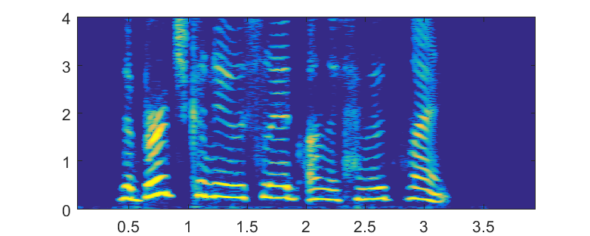
Audio Demos at SNR=5dB
Female Test Set Speaker in Unseen Traffic Noise
Single Stage Baselines
Two-Stage Systems
LSTM-IRM
LSTM-cMSA+CED-cSA-du
(new)
Noisy Speech
Frequency
Real-time factor: 1.14
Frequency
LSTM-MSA
LSTM-cMSA+CED-cSA-tr
(new)
Frequency
Clean Speech
Real-time factor: 0.68
Frequency
LSTM-cMSA
LSTM-cMSA+CLED-cSA-du
[39]
Frequency
Time
Time
Real-time
factor: 1.85

